Slide 1
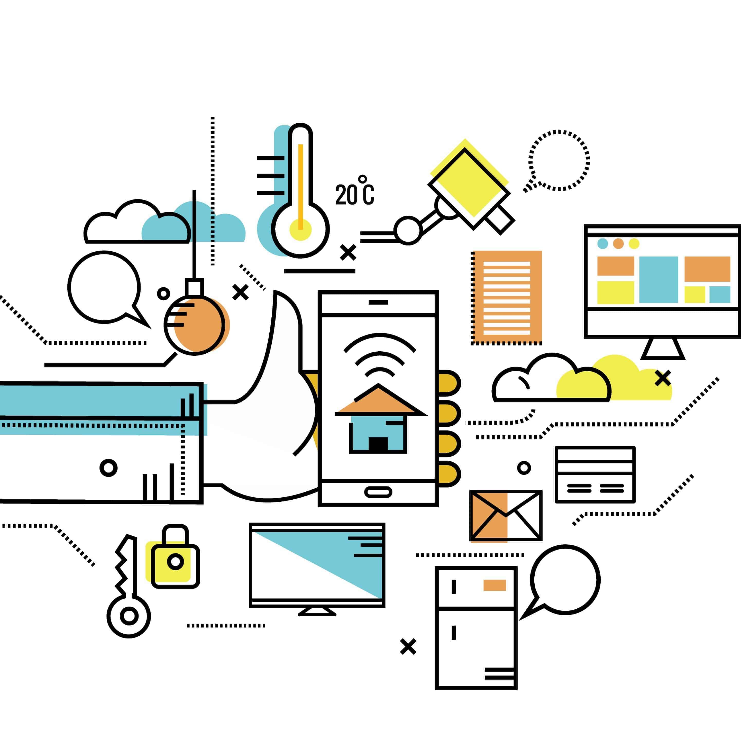
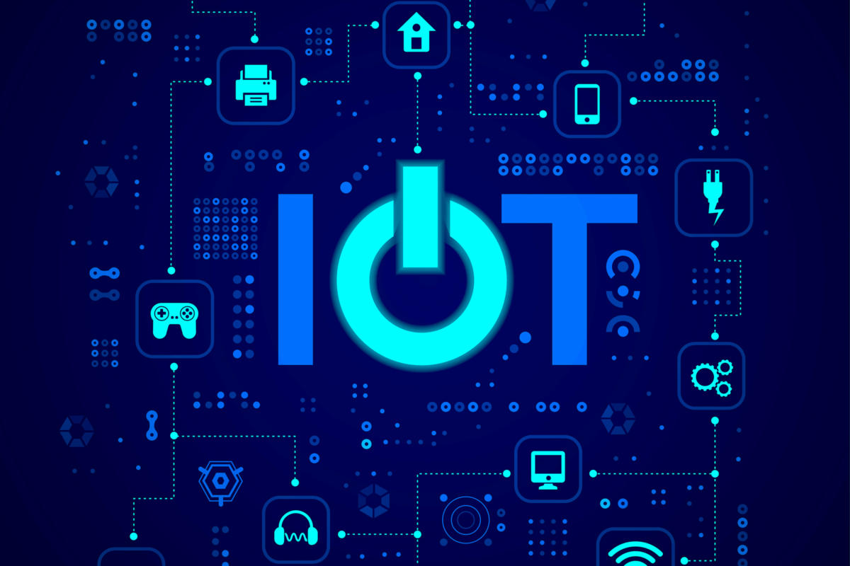
IoT: Track the reading map!

Slide 2
Internet of things (IoT)
Definition: Internet-connected devices (smart devices) exchanging data with each other and communicating with us.
“Thing” in IoT: a person, natural/man-made (artificial) objects that could be assigned an IP address to transfer data over a network.
IoT is not new: The first internet-connected toaster was unveiled in 1989

Slide 3
IoT is growing and we are going to have more smart devices.
A popular smart device: Smart fridge: Fridge is out of milk, check the use-by date
Beyond smart homes and connected devices: IoT is taking us to a smart world
Smart cities
Smart traffic lights
Smart parking lots
Smart bins
Smart industry

Slide 4
Security and privacy are the biggest challenges for IoT. Why?
Connected devices and systems collect personal data and transmit them to the databases of tech companies.
Hackers are not interested in IoT. Why?
* A few people use IoT
* However, if hacking IoT-based devices brings financial benefits for hackers, they commit cybercrimes against IoT.
Tech companies need to provide cyber security to protect the privacy and security of IoT users.

Slide 5
IoT is making its way into different areas of businesses:
IoT & Industry:
Manufacturers (producers) use IoT to organize and track tools/machines/people
Businesses use IoT to lower operating costs, increase productivity, and develop new products
IoT and employers:
Employee’s security access card: track the workers
IoT and farming:
Monitoring crops and cattle (A collective noun. Remember?)
Improving production and efficiency
Tracking the health of the herds
IoT and printer:
Printer is out of toner (ink)
Detailed information about the problems and the parts required to be fixed

Slide 6
The future of IoT
*IoT is real
*Smart devices functioning without human input independently function
*IoT is in its infancy
*Even Google cannot answer how IoT is going to function and change our lives in future

